Slide 1

Decentralized Voting System Using Ethereum Blockchain For Transparent Elections
MCA –II (sem-III) Year Research Project Presentation
-------------------------------------------------------------------------------------------------------
PRESENTED BY : Mr. Mangesh Sunil Ingale.
GUIDED BY : Asst. Prof. Ms. Reeta V. Patil.
HEAD OF DEP. : Dr. Prof. Dinesh D. Puri.
DEPARTMENT OF COMPUTER APPICATIONS
SSBT’s COLLEGE OF ENGINEERING AND TECHNOLOGY
BAMBHORI, JALGAON - 425 001 (MS)
2025–2026

Slide 2

INTRODUCTION
IMPORTANCE
PROBLEM STATEMENT
SOLUTION
MARKET OPPORTUNUTY
OBJECTIVE
SCOPE OF THE SYSTEM
LITERATURE SURVEY
SYSTEM ARCHITECTURE
DIAGRAMS (SYSTEM/ UML/ FLOW )
COMPONENTS OF ETHEREUM
SOFTWARE & HARDWARE REQUIREMENT
CONCLUSION
OUTLINE

Slide 3


INTRODUCTION
Traditional voting systems often face challenges such as fraud, tampering, slow counting, and lack of transparency.
To ensure trustworthy and fair elections, a secure and transparent voting mechanism is needed.
Blockchain technology offers key features such as decentralization, immutability, and transparency, which make it suitable for secure voting.
Ethereum blockchain enables the use of smart contracts to automate, record, and verify votes without human intervention.
In a decentralized voting system, each vote is stored as a tamper-proof transaction, ensuring that election data cannot be altered.
The system enhances security, privacy, auditability, and voter confidence, while also enabling fast and accurate result processing.
Overall, Ethereum-based decentralized voting provides a modern, transparent, and reliable solution for conducting fair digital elections.

Slide 4


IMPORTANCE
Enhanced Transparency
All votes are recorded on a public, tamper-proof ledger.
2. Prevention of Fraud and Tampering
Blockchain’s immutability prevents unauthorized changes.
Improved Security
Cryptographic techniques protect both voter identities and voting data from cyberattacks.
4. Decentralization Removes Single Point of Failure
No central authority controls the data, reducing risks of hacking, corruption, or system failure.
5. Faster Counting and Real-Time Results
Smart contracts automatically count and verify votes.
6. Greater Voter Trust
Transparent and verifiable election data.
7. Increased Accessibility
Enables secure remote voting.
8 Cost Reduction
Reduces expenses related to manpower, ballot printing, physical polling booths, and transportation.

Slide 5
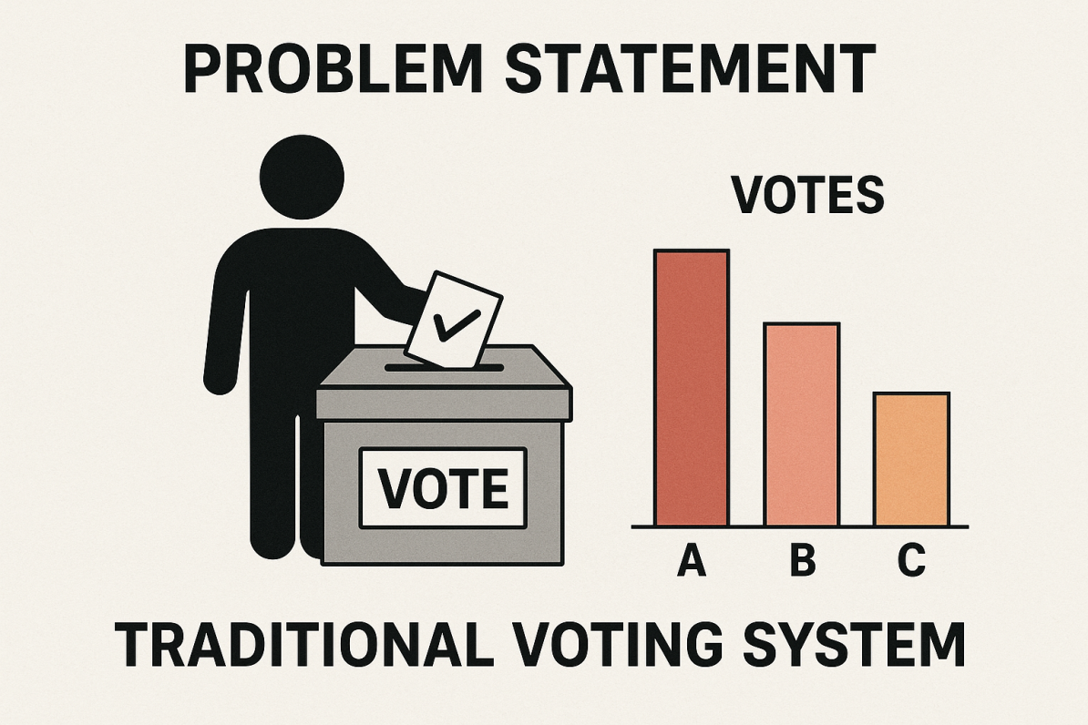
PROBLEM STATEMENT
Traditional voting systems lack transparency and citizens cannot verify vote accuracy.
Centralized databases are vulnerable to hacking and manipulation.
Manual counting causes delays and increases human error.
Weak voter verification can lead to duplicate or unauthorized voting.
Limited accessibility affects remote, elderly, and overseas voters.
High operational costs make elections expensive.
No end-to-end auditability, making independent verification difficult.
Public trust decreases due to poor security and transparency.

Slide 6
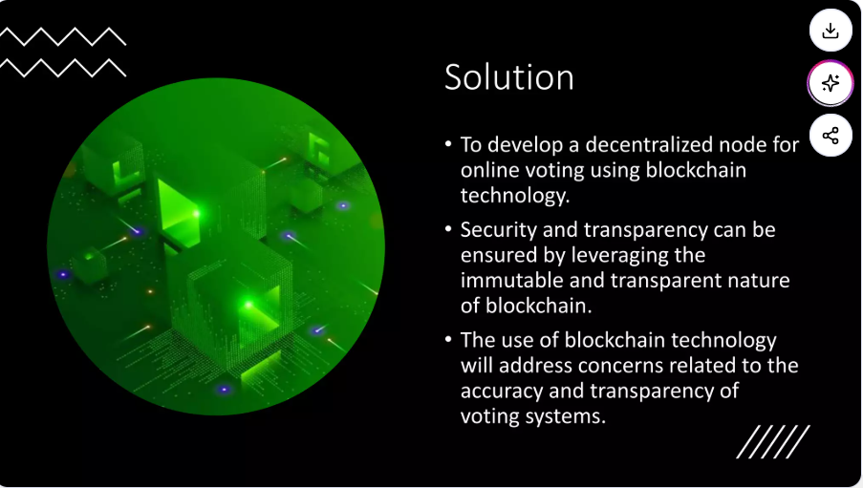

Slide 7
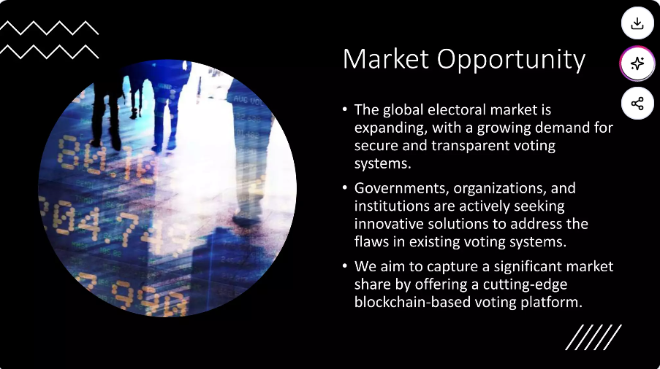

Slide 8

OBJECTIVE
Ensure Transparency
Increase Security
Prevent Voter Fraud
Guarantee Data Integrity
Enhance Trust in Elections
Enable Real-Time Vote Counting
Improve Accessibility
Reduce Operational Costs
Provide Auditability
Decentralize Control

Slide 9
SCOPE OF THE SYSTEM
Enables secure digital voting using Ethereum blockchain technology.
Provides a tamper-proof, immutable ledger for recording all votes.
Ensures transparency by allowing public verification of votes without exposing voter identity.
Supports voter authentication using cryptographic techniques or digital identities.
Allows real-time vote counting with automatic tallying via smart contracts.
Facilitates remote voting through decentralized applications (DApps).
Reduces dependence on centralized authorities, minimizing risks of fraud or manipulation.
Provides auditable election results accessible to all stakeholders.
Maintains anonymity and privacy using secure encryption methods.
Supports scalability and integration with government e-ID systems or biometric verification (optional).

Slide 10

LITERATURE SURVEY
Blockchain Voting Overview: Studies show blockchain improves transparency, immutability, and auditability in e-voting.
Ethereum-based Voting Models: Research highlights use of smart contracts for secure vote casting,
automated tallying, and tamper-proof storage.
Security & Privacy Techniques: Literature emphasizes cryptographic tools like zero-knowledge proofs,
encryption, and anonymity schemes to protect voter identity.
End-to-End Verifiability: Papers propose systems where voters can verify their votes without revealing personal data.
Scalability & Performance Issues: Many studies point out Ethereum gas cost, transaction speed, and scalability limitations.
Identity & Authentication: Research includes digital ID integration, PKI-based authentication, and prevention of double-voting.
Challenges Identified: Privacy leakage on public chains, coercion resistance, usability issues, and regulatory barriers.

Slide 11
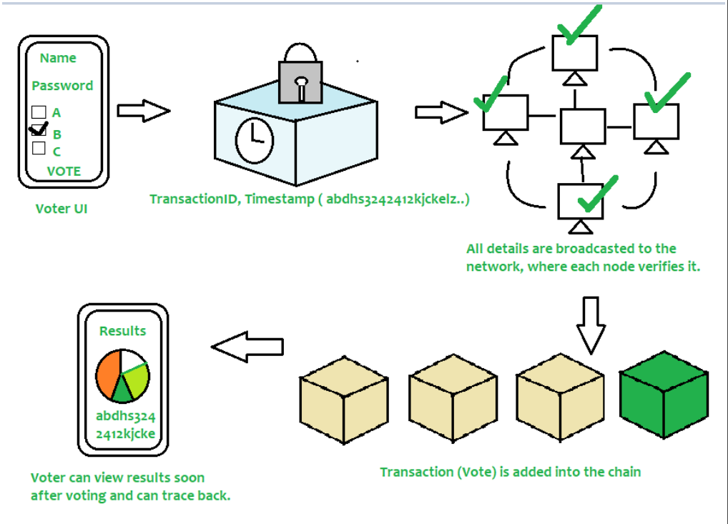
SYSTEM ARCHITECTURE
Voter
Registers and authenticates
Casts vote securely
User Interface (Web / Mobile DApp)
Provides voting dashboard
Connects voter wallet (MetaMask)
Authentication Module
Verifies voter identity
Prevents duplicate voting
Ethereum Smart Contract
Stores candidates and votes
Ensures one-person-one-vote
Executes voting rules automatically
Ethereum Blockchain Network
Records votes immutably
Provides transparency and security
Consensus Mechanism
Validates transactions
Prevents tampering and fraud
Admin / Election Authority
Deploys smart contract
Manages election setup (candidates, duration)
Result Module
Fetches real-time results
Publicly verifiable and transparent

Slide 12
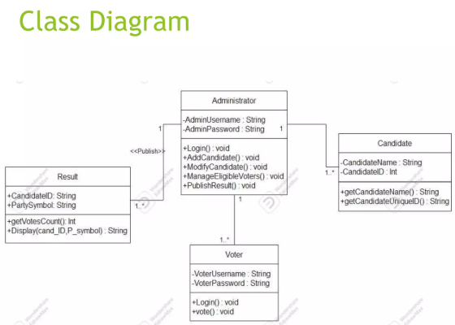
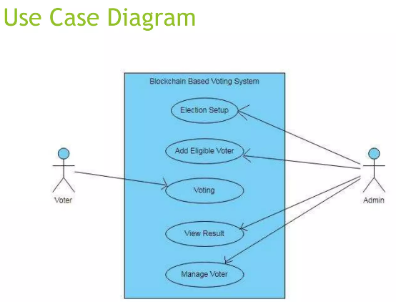
DIAGRAMS
System Architecture Diagram
Block Diagram
Flowchart Diagram
Data Flow Diagram (DFD)
Sequence Diagram
Use Case Diagram
Component Diagram
Deployment Diagram

Slide 13
SOFTWARE & HARDWARE REQUIREMENT
Software Requirements
Operating System – Windows / Linux / macOS
Programming Language – Solidity, JavaScript
Blockchain Platform – Ethereum
Smart Contract Tools – Remix IDE / Truffle
Web Framework – React.js / HTML, CSS
Wallet – MetaMask
Web3 Library – Web3.js / Ethers.js
Database (Optional) – MongoDB / MySQL
Browser – Google Chrome
Hardware Requirements
Processor – Intel i3 or above
RAM – Minimum 4 GB (8 GB recommended)
Hard Disk – 20 GB free space
Internet Connection – Required
Client Device – PC / Laptop / Mobile

Slide 14
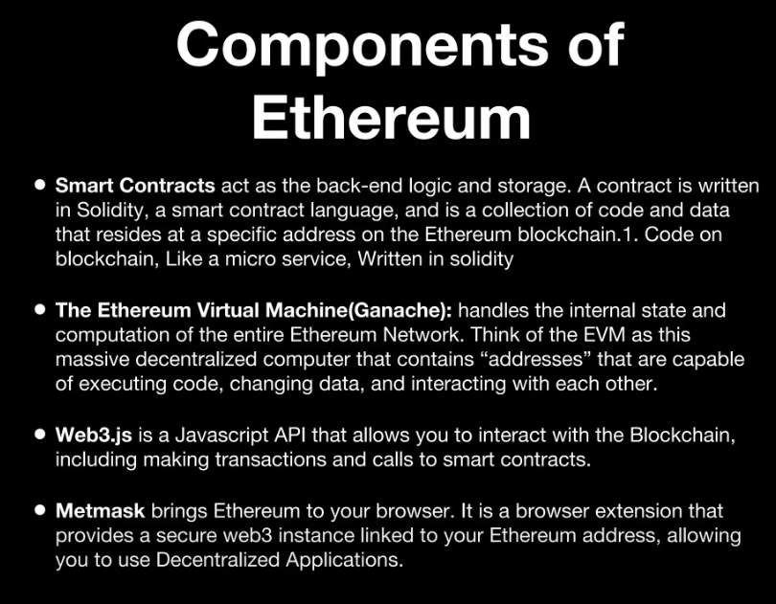

Slide 15
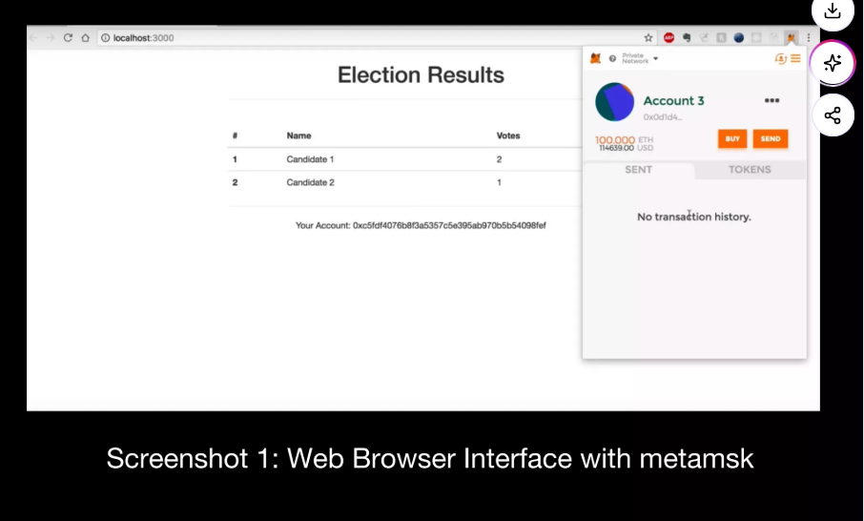

Slide 16
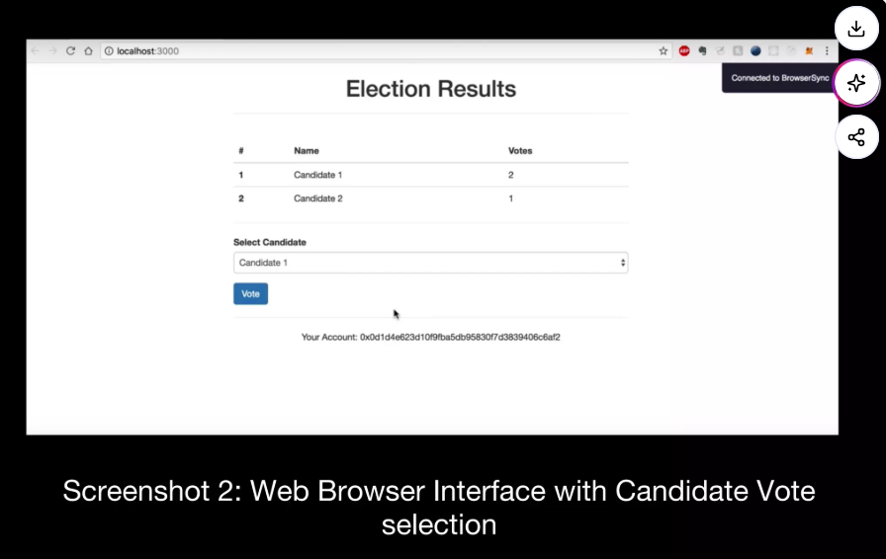

Slide 17
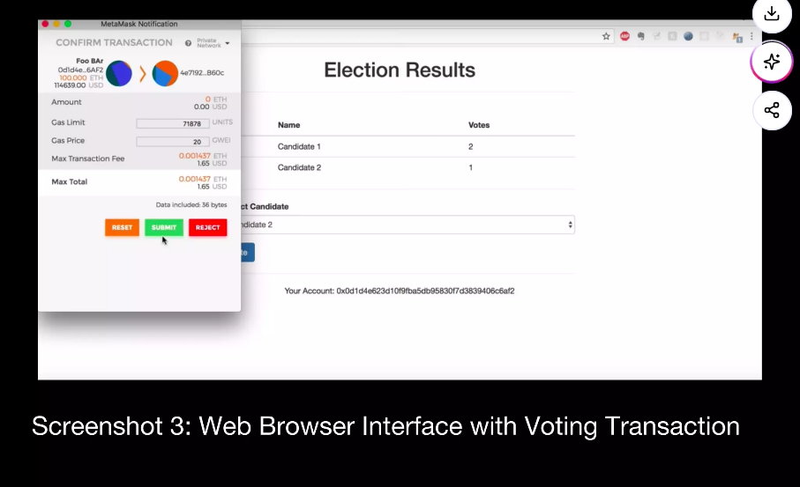

Slide 18
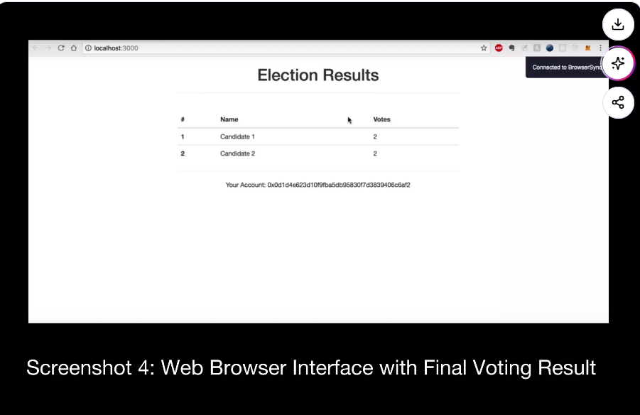

Slide 19
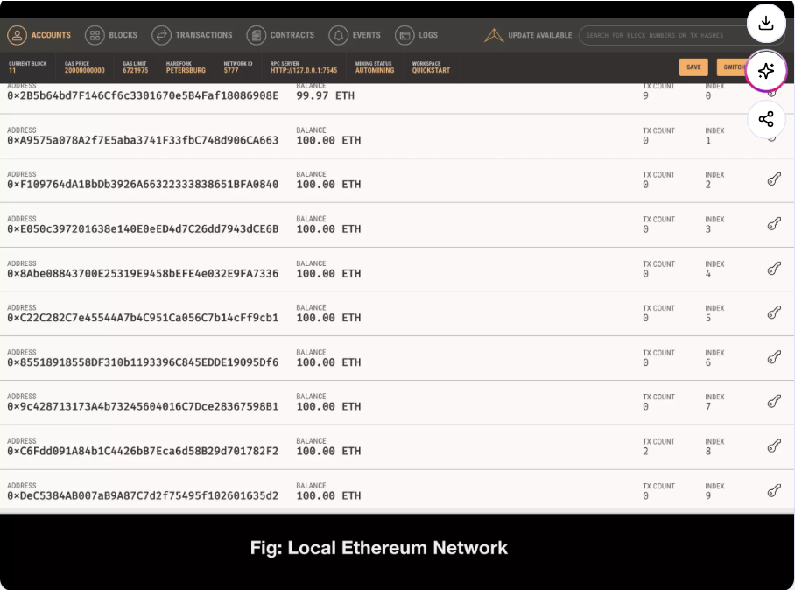

Slide 20
CONCLUSION
The decentralized voting system ensures transparency, security, and trust using Ethereum blockchain.
Smart contracts eliminate tampering, duplication, and manual errors.
Blockchain provides immutable and verifiable voting records.
The system reduces fraud and third-party interference.
It enables secure, fast, and cost-effective elections.
Overall, the project demonstrates the effectiveness of blockchain for transparent digital elections.

Slide 21
Thank You
Notes:
Thank You

